Slide 1
Databases
Overview

Slide 2
Definition
A database is really any collection of related data.
It could be a spreadsheet, a contact list or a full-blown relational database system like Oracle or Sql server.

Slide 3
Uses of Databases
Storing business transaction data
Storing scientific data
Storing and managing medical data
Content management for web pages
Managing and tracking back-end transactions such as virtual machines in the cloud
Storing and managing metadata

Slide 4

Types of Databases
Even a rolodex is a database, though we usually think of electronic, computer-based databases.
A rolodex was a way of keeping addresses and phone numbers

Slide 5
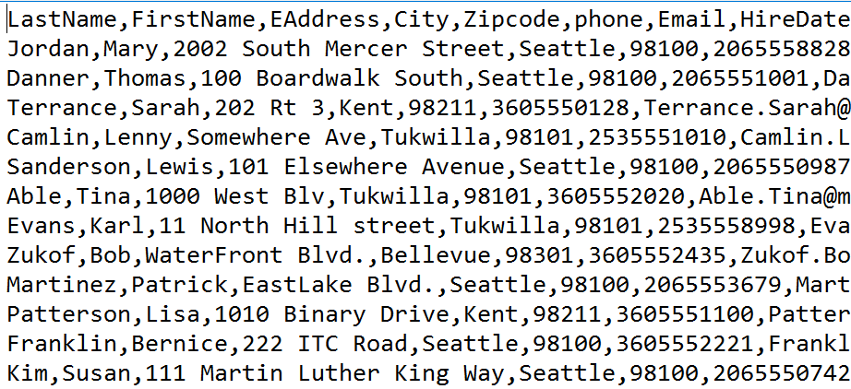
Flat Files
Flat files are just files of data with each piece of data separated by a delimiter such as a comma, or given a fixed width.

Slide 6

Flat Files Continued
Flat files are useful for transferring data from one database system to another or for storing simple data that a program may need to operate.
A special type of flat file database is a spreadsheet. Spreadsheet programs like Excel are still flat file because they store their data in a single file, but they have many other features for analysing, sorting and querying the data.

Slide 7
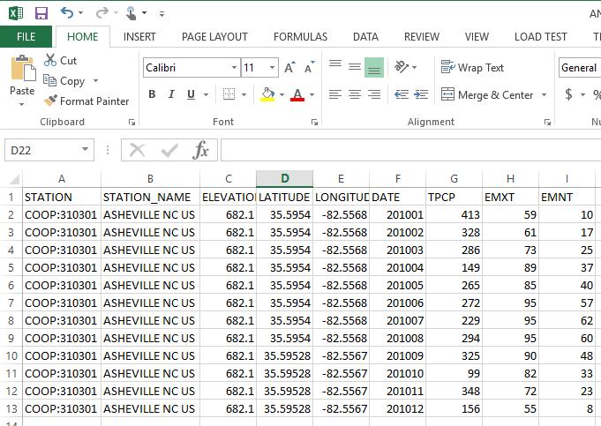
Excel

Slide 8
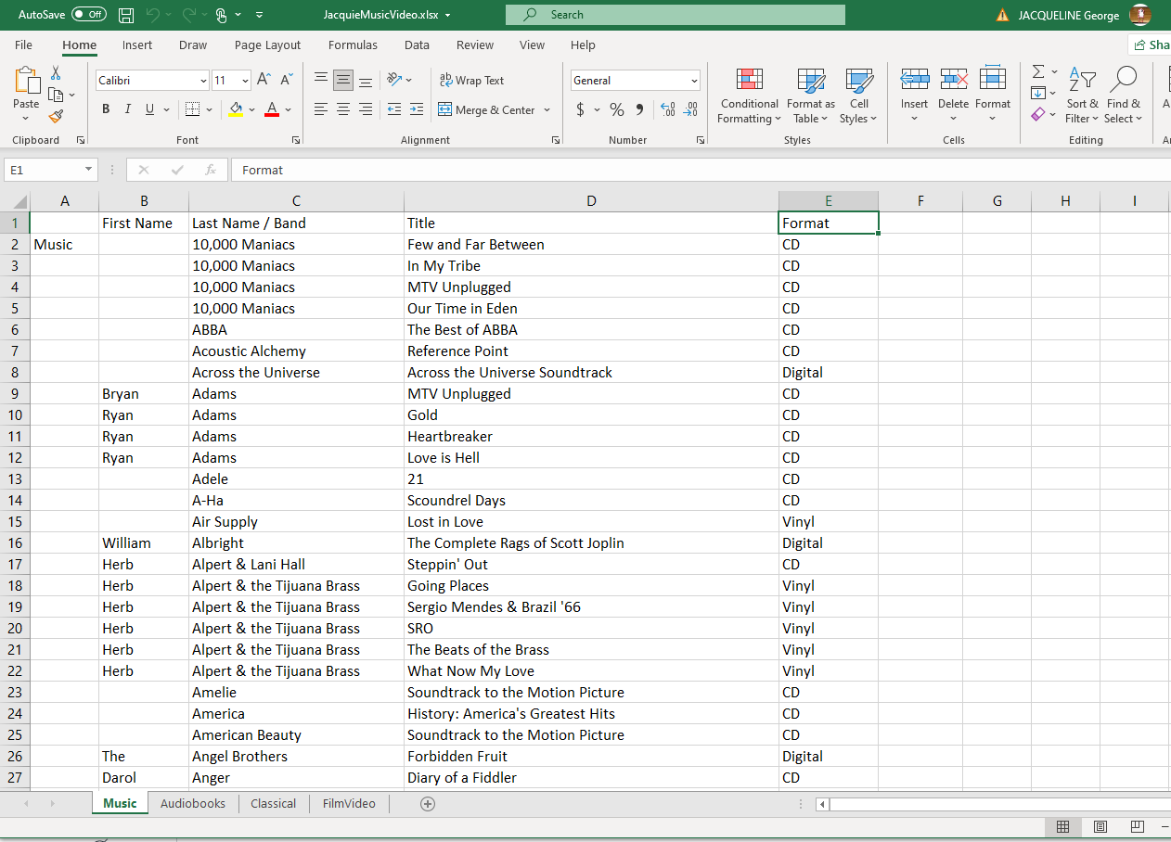
Excel

Slide 9
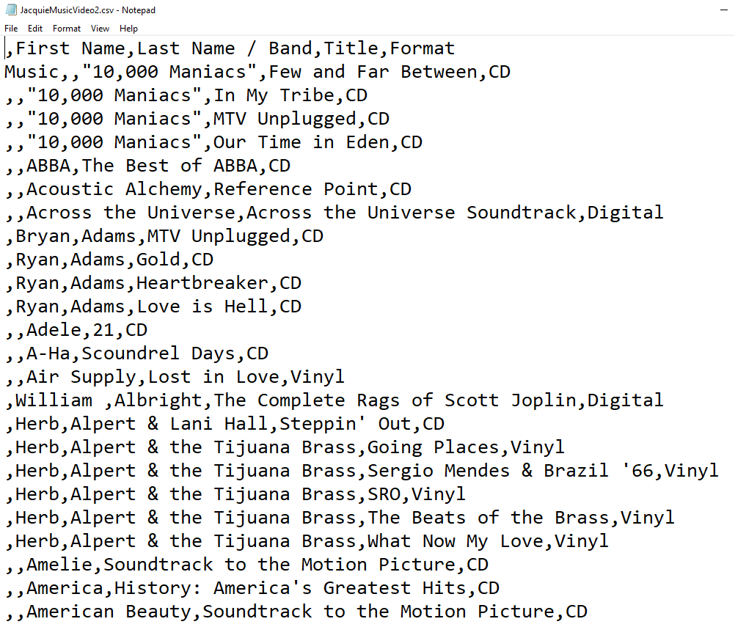
Excel

Slide 10
Advantages/Disadvantages
Flat files are lightweight making them easy to use and transport.
They are generally just text files and don’t require any special software.
They are generally humanly readable.
No data type enforcement
Redundancy--data is often repeated in multiple places.
Hard to query data, especially across multiple files.

Slide 11
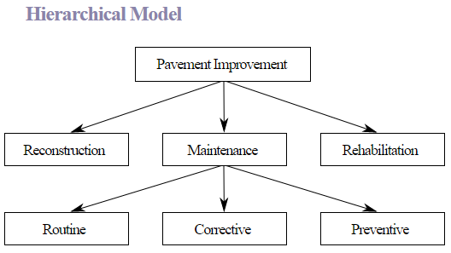
Hierarchical Databases
Hierarchical database store their data in a tree structure that resembles a file system. There is a root or trunk and then branches of data. Branches can have sub branches (Just as folders can contain folders.)
Hierarchical database were used a lot in the early days of computerized databases, especially by large institutions such as banks and insurance companies. Many still maintain their large hierarchical databases simply because they have so much money and data invested in them.

Slide 12
Advantages/Disadvantages
Easy to Navigate, just like navigating file folders
Relatively fast
Redundancy--the need to store the same information in more than one place
Difficult to compare data across folders

Slide 13
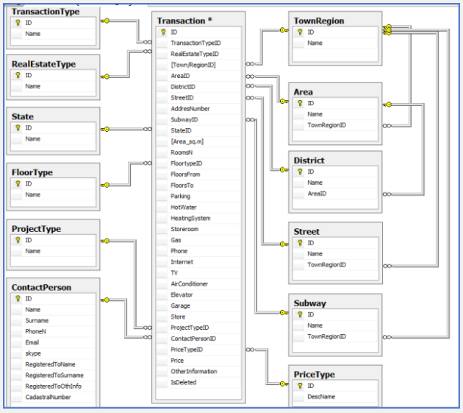
Relational Databases
Relational databases originated in the 1970’s.
For the last 40+ years they have dominated the database marked.
Relational databases divide the data into separate tables. Information is only entered in one place. Tables relate to each other by means of keys. The key field in on table (the primary key) is repeated in another table to make the connection between the data.

Slide 14
Relational Databases
Relational databases were developed to solve problems that plagued early database designs such as the hierarchical and network designs
These problems included
Redundancy--data repeated in more than one place
Difficulties in comparing and relating data from different nodes
Scalability

Slide 15
Types of Relationships
There are only three types of relationships between entities in a relational database:
One to one: This means for every record in Table1, There is exactly one related record in Table2. This is a rare relationship.
One to Many: For every record in Table1, there can be zero to any number of related records in Table2. This is the relationship of 99% of all tables in a relational database.
Many to Many: This says that Table1 can have many related records in Table2, and Table2 can have many related records in table one. This relationship cannot be resolved by a relational database. You must make a Linking table that converts the many to many relationship into two one to many relationships.

Slide 16
Database Design
All relational databases regardless of the product share the same design principles
Everything must be broken into entities(tables)
Entities consist of attributes (columns) that describe that entity
Every entity should have a primary key that uniquely identifies each row
That primary key can be repeated in other tables, showing a relationship between the tables. A primary key repeated in another table is called a Foreign Key
Foreign keys are the only redundancy (repeated values) allowed in the relational database

Slide 17
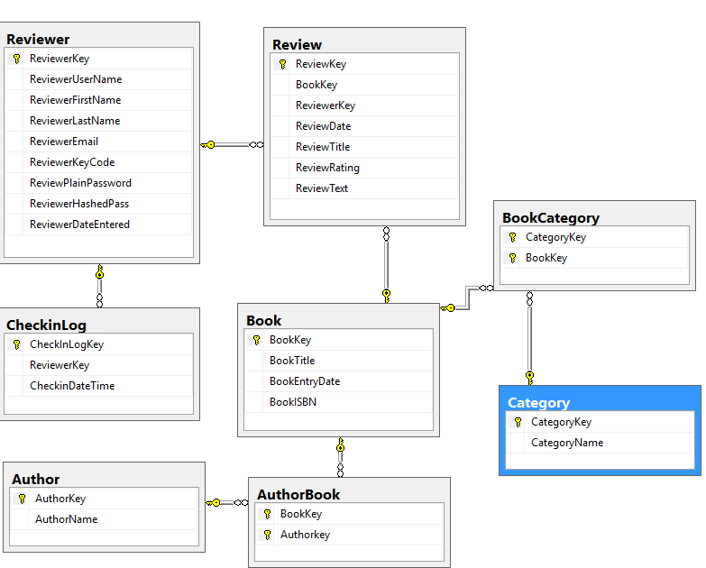
Relational Diagram

Slide 18
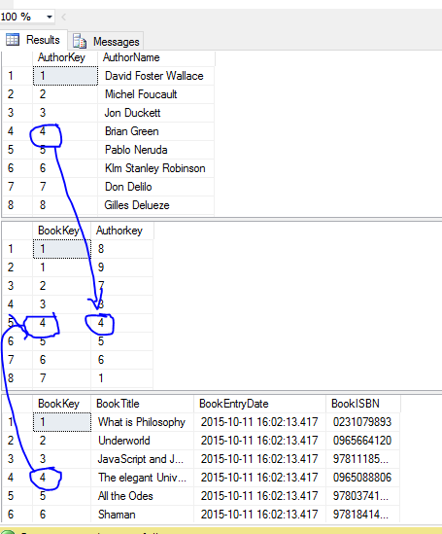
Relational Tables
Note the Primary key for Author Is related to the author key in BookAuthor. The primary Key For Book is related to the BookKey In AuthorBook

Slide 19
Advantages/Disadvantages
Relational databases offer relational integrity, meaning data is only ever entered and updated in one place. This prevents many errors.
Also relational database are easy to query. Any piece of data can be related to any other piece of data.
The primary drawback is complexity. Relational database divide data into multiple tables which are not necessarily humanly readable.
It is fairly easy to make a bad database that will not fulfill its business requirements.

